Slide 1
ATAI
Advanced Techniqueof Artificial Intelligence
ATAI
ChongqingUniversity _{AdvancedTechniqueof}
of Technology Artificial Intelligence
Chongqing University of
Technology
Chongqing University ^{ATAI}
_{of Technology} Advanced Techniqueof
Artificial Intelligence
Chongqing University of Technology
Chongqing University of Technology
Embracing Unimodal Aleatoric Uncertainty for Robust Multimodal Fusion
Embracing Unimodal Aleatoric Uncertainty for Robust Multimodal Fusion
Code:None
—— CVPR 2024
Reported by Tingting Zhang
1

Slide 2
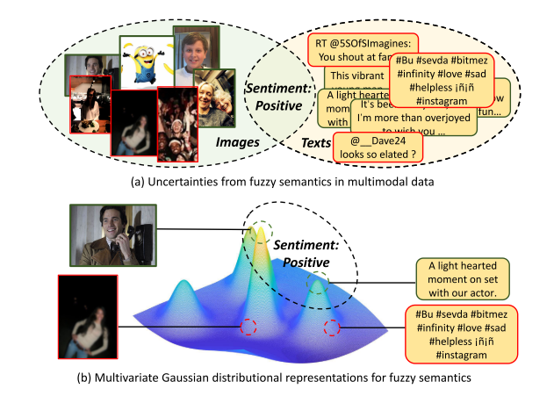
ATAI
AdvancedTechniqueof
Artificial Intelligence
ATAI
ChongqingUniversity _{AdvancedTechniqueof}
of Technology Artificial Intelligence
ChongqingUniversity of Technology
Motivation
the unimodal data in their unique embedding space mostly contains potential noise, which leads to corrupted cross-modal interactions(the introduced noise comes from the aleatoric uncertainty).
1. Can we quantify the uncertainty in multimodal data?
2. Is it appropriate to completely drop the intrinsic uncertainty?
Notes:
单一模态数据在其独特的嵌入空间中往往包含潜在噪声，导致跨模态交互受到干扰
1. 能否量化多模态数据中的不确定性？论文提出利用高斯分布来表示每个实例，将其视为多元正态分布，其中方差代表内在的不确定性。
2. 完全忽视这种内在的不确定性是否合适？即使在语义上相似的图像-文本对中，也会有不可避免的aleatoric uncertainty。
在图(a)中，图片和文本都被标注为“积极情感（Sentiment: Positive）”，但这些数据本身可能存在噪声。例如，一些图片和文本的情感表达可能不明确，或者因为模糊的语义或主观性，导致人们对这些数据的情感判断存在不确定性。
红色框中的内容可能包含更高的不确定性，说明这些模态数据的表达可能会因为语义的模糊性而产生噪声。
这部分的主要目的是展示多模态数据由于其固有的模糊性，容易引入噪声和不确定性。
在图(b)中，通过多元高斯分布来表示模糊的语义。这种表示方式可以将语义相近但模态不同的数据通过概率分布表示在同一个隐空间中。
不同数据点在高斯分布中可能聚集成不同的峰，代表各个模态的语义集中区域。例如，情感为“积极”的图片和文本尽管存在噪声，但可以在这个多模态隐空间中映射为相似的分布。
这个图展示了如何通过高斯分布的方差来量化数据的不确定性，从而在模糊语义环境中更好地表示不同模态的数据。

Slide 3
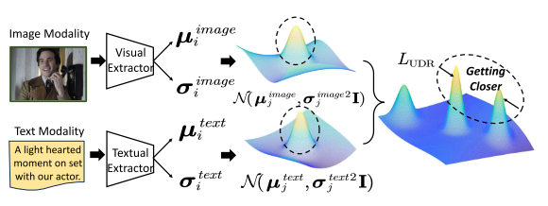
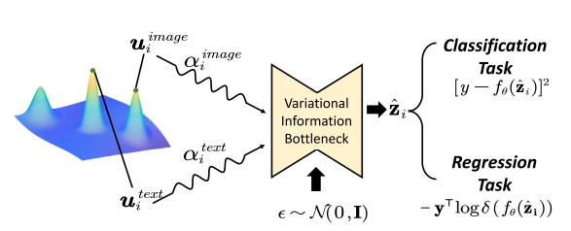
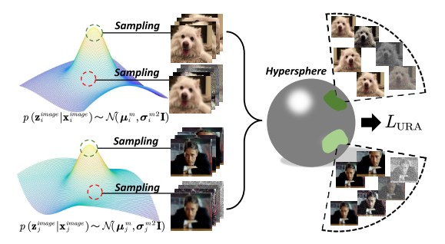
ChongqingUniversity of Technology
ATAI
AdvancedTechniqueof
Artificial Intelligence
ATAI
ChongqingUniversity _{AdvancedTechniqueof}
of Technology Artificial Intelligence
Overview
1. Unimodal Distributional Representation
3. Robust Multimodal Feature Integration
2. Uncertainty-based Representation Augmentation

Slide 4
ChongqingUniversity of Technology
ATAI
AdvancedTechniqueof
Artificial Intelligence
ATAI
ChongqingUniversity _{AdvancedTechniqueof}
of Technology Artificial Intelligence
Method
1. Uncertainty Estimation in Deep Learning Models
2. Stable Unimodal Feature Augmentation
2. 1 Unimodal Distributional Representation

Slide 5
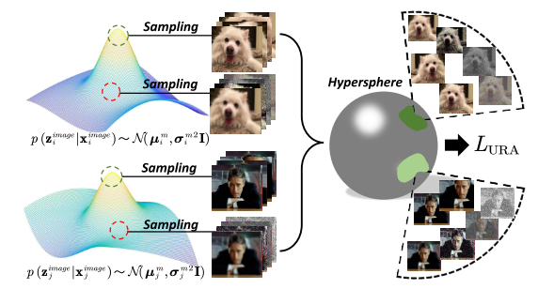
ChongqingUniversity of Technology
ATAI
AdvancedTechniqueof
Artificial Intelligence
ATAI
ChongqingUniversity _{AdvancedTechniqueof}
of Technology Artificial Intelligence
Method
2. Stable Unimodal Feature Augmentation
2.2 Uncertainty-based Representation Augmentation

Slide 6
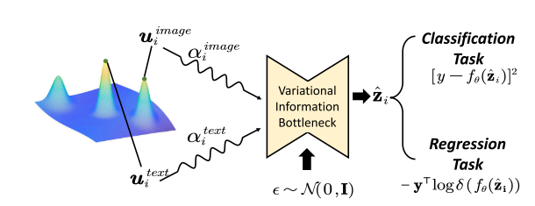
ChongqingUniversity of Technology
ATAI
AdvancedTechniqueof
Artificial Intelligence
ATAI
ChongqingUniversity _{AdvancedTechniqueof}
of Technology Artificial Intelligence
Method
3. Robust Multimodal Feature Integration
3.1 Dynamic Multimodal Integration
3.2 Joint Representation Compression

Slide 7
ATAI
AdvancedTechniqueof
Artificial Intelligence
ATAI
ChongqingUniversity _{AdvancedTechniqueof}
of Technology Artificial Intelligence
ChongqingUniversity of Technology
Experiments
The CMU-MOSI and CMU-MOSEI datasets contain videos, audios, and texts.
The MVSA-Single and Food-101 datasets consist of texts and RGB images.
The NYU Depth v2 contains RGB and depth images.

Slide 8
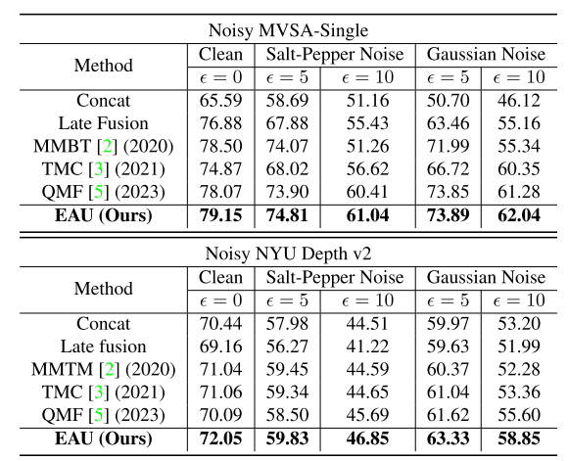
ATAI
AdvancedTechniqueof
Artificial Intelligence
ATAI
ChongqingUniversity _{AdvancedTechniqueof}
of Technology Artificial Intelligence
ChongqingUniversity of Technology
Experiments

Slide 9
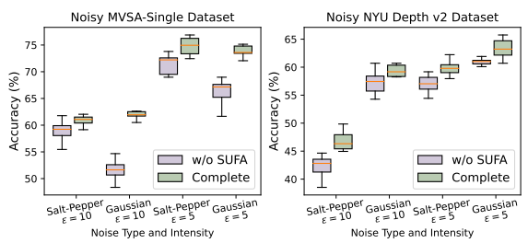
ATAI
AdvancedTechniqueof
Artificial Intelligence
ATAI
ChongqingUniversity _{AdvancedTechniqueof}
of Technology Artificial Intelligence
ChongqingUniversity of Technology
Experiments
Stable Unimodal Feature Augmentation

Slide 10
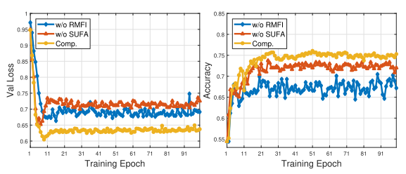
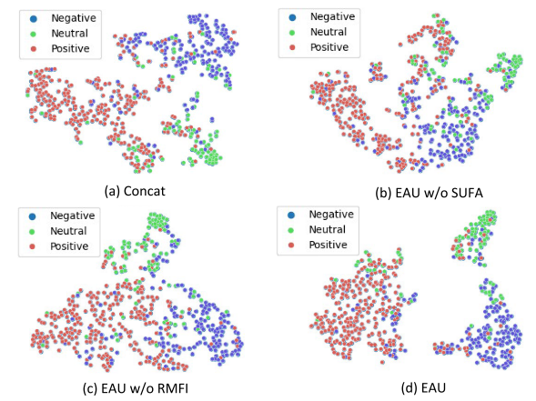
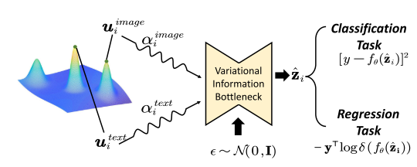
ATAI
AdvancedTechniqueof
Artificial Intelligence
ATAI
ChongqingUniversity _{AdvancedTechniqueof}
of Technology Artificial Intelligence
ChongqingUniversity of Technology
Experiments
Robust Multimodal Feature Integration

Slide 11
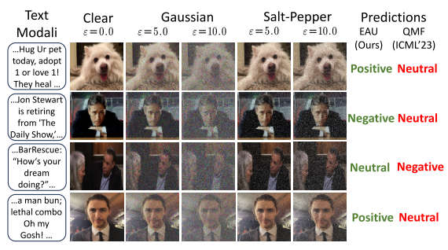
ATAI
AdvancedTechniqueof
Artificial Intelligence
ATAI
ChongqingUniversity _{AdvancedTechniqueof}
of Technology Artificial Intelligence
ChongqingUniversity of Technology
Experiments

Slide 12
ChongqingUniversity of Technology
ATAI
AdvancedTechniqueof
Artificial Intelligence
ATAI
ChongqingUniversity _{AdvancedTechniqueof}
of Technology Artificial Intelligence
Thanks!

